Slide 1
Приёмы смыслового чтения на уроках английского языка
Учитель: Кизик Екатерина Алексеевна
МОУ СОШ №13
Оленегорск, 2020

Slide 2
Смысловое чтение
вид чтения, которое нацелено на понимание читающим смыслового содержания текста.

Slide 3
В концепции универсальных учебных действий выделены действия смыслового чтения, связанные:
- с осмыслением цели и выбором вида чтения в зависимости от коммуникативной задачи;
- с определением основной и второстепенной информации;
- с формулированием проблемы и главной идеи текста.

Slide 4
Приёмы смыслового чтения
- предтекстовый этап,
- этап работы с текстом во время чтения,
посттекстовый этап.

Slide 5
Put the paragraphs in the right order.
From: Rosa
To: Lizzie
Subject: Season’s greetings
Dear Lizzie,
________________________________________________________________
What about you? How are you spending New Year’s Eve (канун)? Whatever you are doing, have a wonderful time. I wish you and your family a Happy New Year.
_______________________________________________________________
We are very busy at the moment. Dad is doing the last minute shopping. Mum is making a special dish, fried baby eels. They’re delicious, honest! Aunt Betsie is making tea for everyone and Grandma is doing the gardening. Clara and Steve are doing the washing-up. Steve is also washing the grapes for tonight. In Spain, it’s good luck to eat twelve grapes at midnight on New Year’s Eve! As for the twins, they are making the decorations. They are excited. Spanish people call New Year’s Eve Nochevieja, which means the old night. This is because the 31st of December is the last night of the old year.
__________________________________________________________________
How’s everything back in NY? I hope the weather isn’t too cold. Here in Madrid, everyone is getting ready to celebrate (праздновать) New Year’s Eve. The shops are full of people. They are buying presents and food. Council workers are decorating the streets and making preparations for tonight’s celebrations in the Plaza del Sol.
All the best!
Rosa

Slide 6
Цель предтекстовых стратегий:
- постановка цели и задач чтения;
- знакомство с важными понятиями, терминами, ключевыми словами;
- актуализация предшествующих знаний;
- прогнозирование содержания.

Slide 7
Pre-reading tasks
What was it? A letter.
Who is the letter from? – from Rosa
To whom? – to Lizzie
What is it about? – it’s about holiday.
What is the holiday? – it’s New Year.
What is the country? – Spain.
What is the town? – Madrid.

Slide 8
Цель стратегий
текстовой деятельности:
- смысловая догадка;
- анализ;
- интерпретация.

Slide 9
While-reading tasks
read the text
put the paragraphs in the right order
listen and check
1st group will write out the nouns (who)
2nd group – what are they doing?
write out these words and phrases on the sheets of paper and put them on the blackboard

Slide 10
Цель стратегий постчтения:
- применение материала;
- усвоение, расширение материала;
- обсуждение прочитанного;
- включение в другую деятельность.

Slide 11
Post-reading tasks
do the test;
make your sentences using the text and notes on the blackboard;
retell the story using the phrases on the blackboard;
answer the questions.

Slide 12
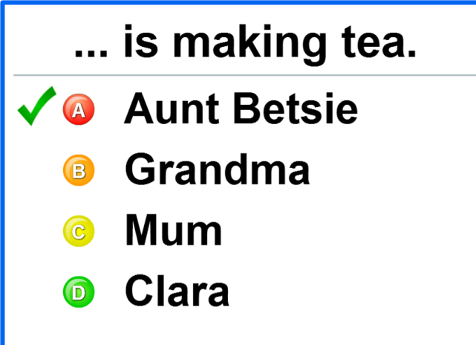
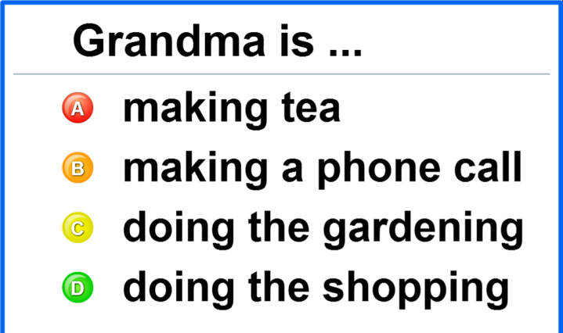
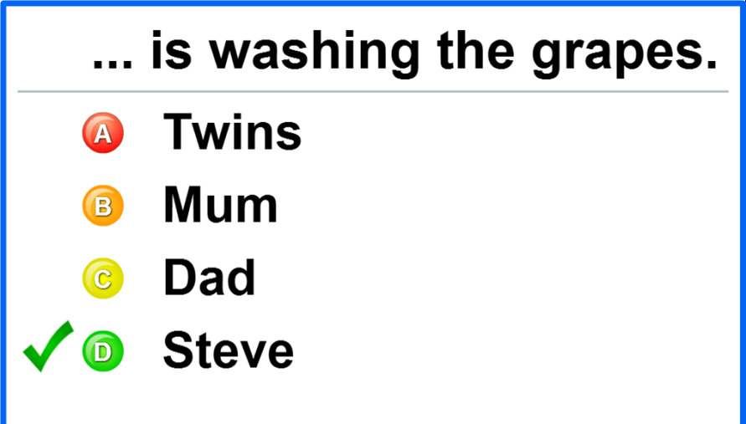
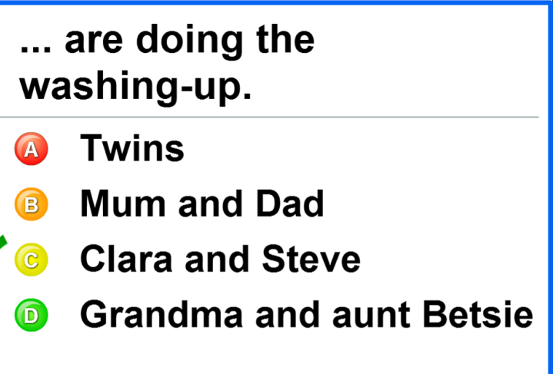
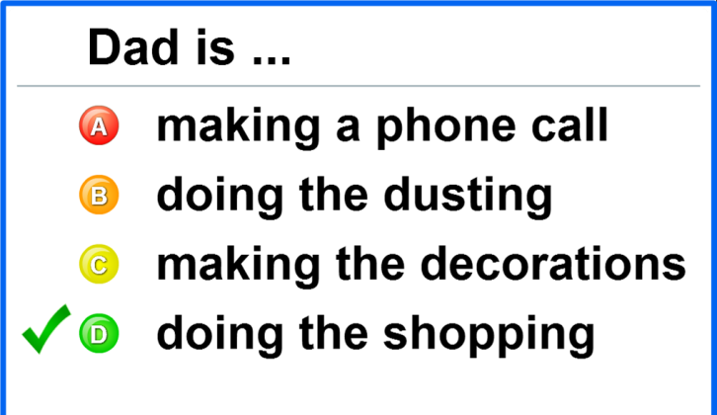

Slide 13
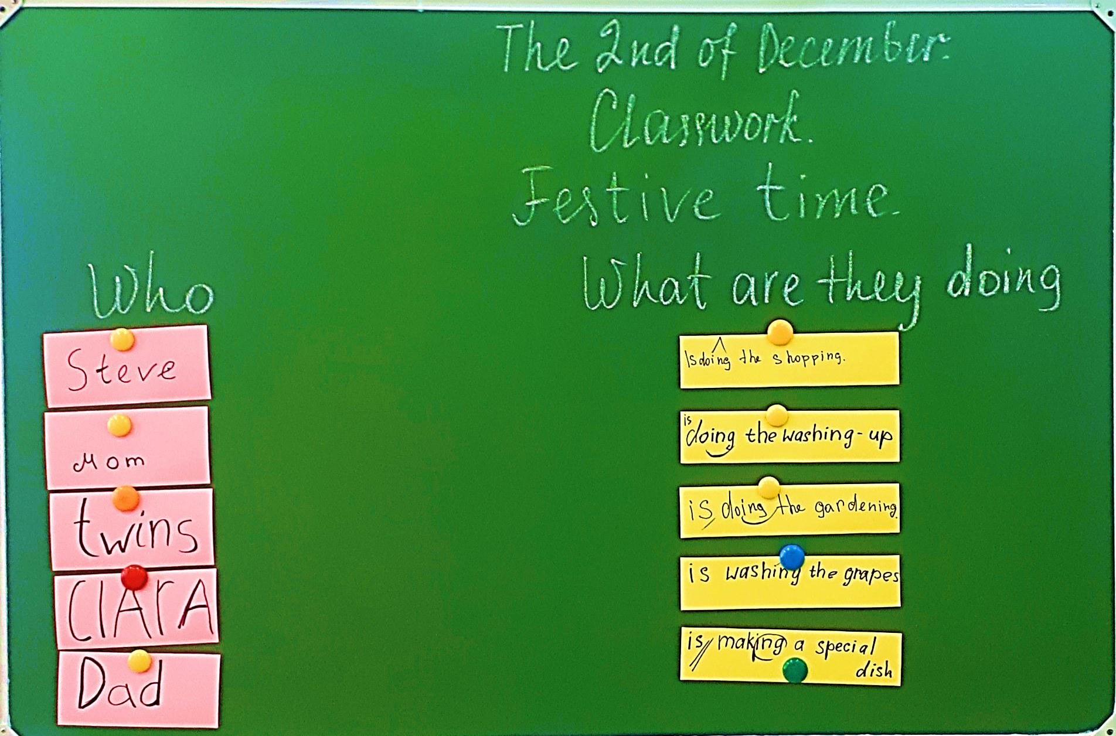

Slide 14
Retell the story. Use these phrases:
This is the letter from … to …
They live in …
They are going to celebrate …
Dad is …
Mum …
Grandma …
Aunt Betsie …
…
…
New Year’s Eve is a … …!

Slide 15
When do we celebrate the New Year’s Eve?
What is the tradition at midnight in Spain?
How do they call this night?

Slide 16
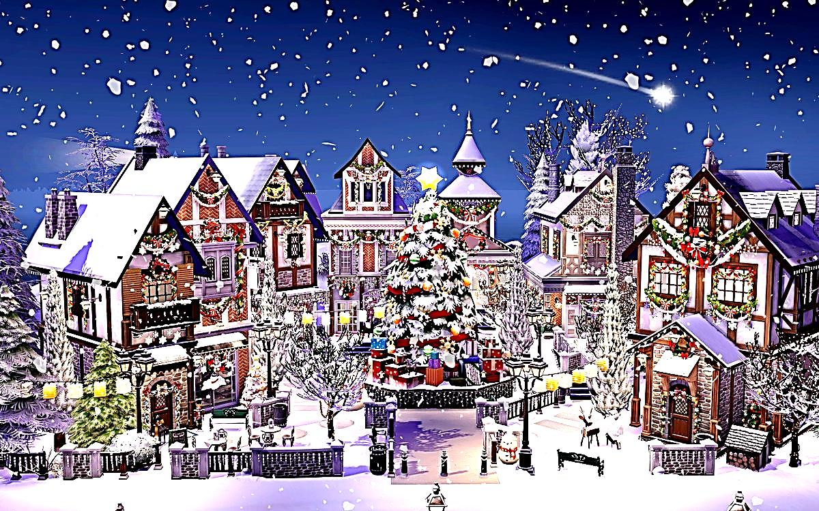
NOCHEVIEJA the 31st of December the old night

Slide 17
СПАСИБО ЗА ВНИМАНИЕ!

